Slide 1

Institute of Advance Education & Research
Affiliated to
Maulana Abul Kalam Azad University of Technology
Department of Data Science
Final Year Project
Subject Code: BBARE - 682
Presented By: Ritam Biswas, Srija Mondal, Neelavo Dutta

Slide 2



Exploratory Data Analysis and Machine Learning Approach to Predict Wine Quality Using Python
This project uses machine learning to predict wine quality. We focus on red wine data with key metrics like Volatile Acidity, Citric Acid, Alcohol, pH, and Quality for analysis.
Presented by - Ritam Biswas, Srija Mondal, Neelavo Dutta

Slide 3

Tools and Technologies
Python
Pandas & NumPy
Main language for data processing and modeling
Data manipulation, analysis, and numerical computations
Matplotlib & Seaborn
Scikit-learn
Visualizing data patterns and statistical distributions
Building and evaluating machine learning models

Slide 4
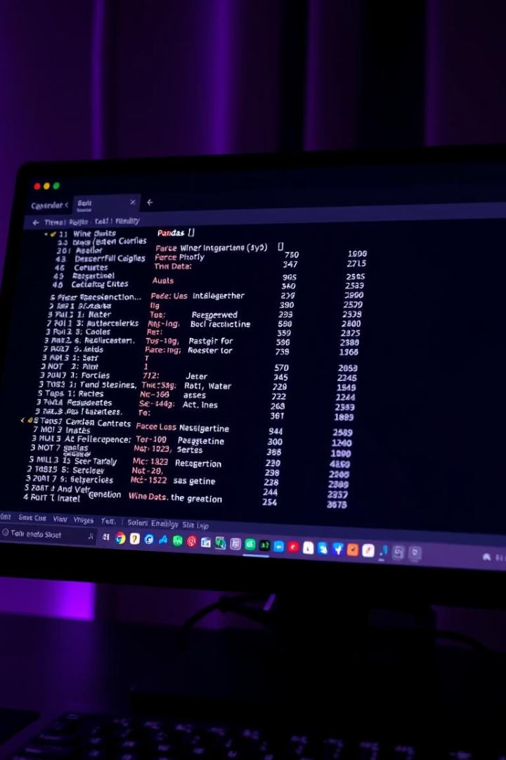




Data Loading and Inspection
Load Dataset
Use Pandas to import the wine quality CSV file
Initial Inspection
Check first rows, data types, and missing values
Statistics Overview
Generate descriptive statistics to summarize data
Target Variable
Quality scores range from 1 to 10 for prediction

Slide 5
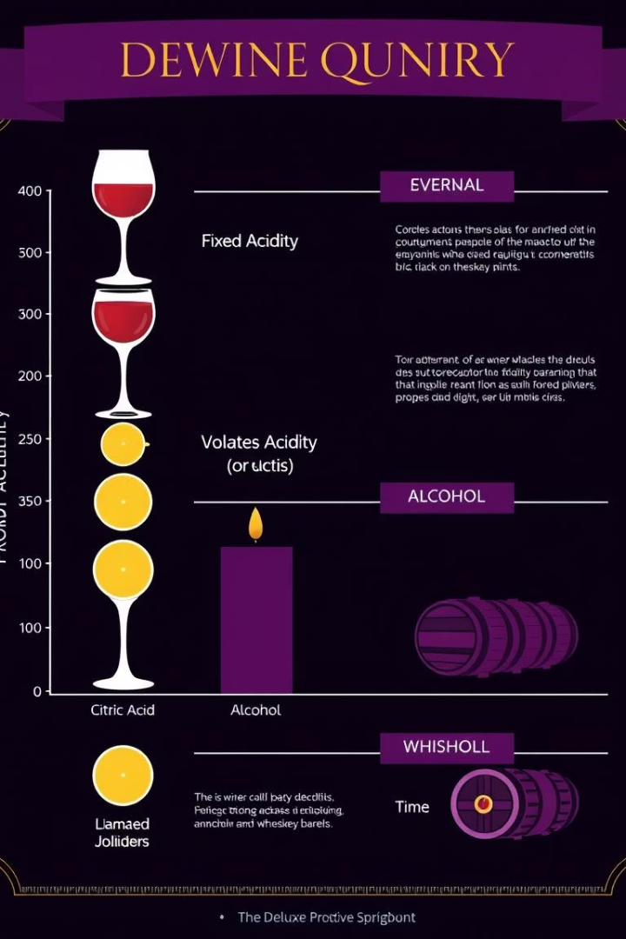
Exploratory Data Analysis: Univariate
Key Metrics
Quality mode: 6, Fixed Acidity mean: 6.854
Feature Means
Volatile Acidity: 0.2782, Citric Acid: 0.3341
Distribution Insights
Identify skewness and outliers impacting results
Alcohol Content
Varies widely, influencing quality perception

Slide 6
EDA: Bivariate and Multivariate Analysis
Scatter Plots
Correlation Matrix
Box Plots
Key Insights
Assess relationships like Volatile Acidity vs. Quality
Visual heatmap shows feature interdependencies
Compare feature spread across quality levels
Spot key drivers influencing wine quality outcomes

Slide 7
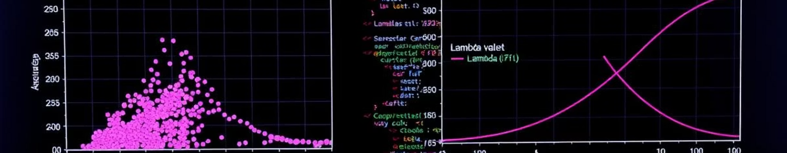
Handling Skewness and Outliers
Benefit
Treatment
Normalization enhances model learning and predictions
Detect Outliers
Remove or adjust outliers to improve model accuracy
Skewed Data
Apply IQR or Z-score methods to identify anomalies
Use log or Box-Cox transformations to normalize features

Slide 8
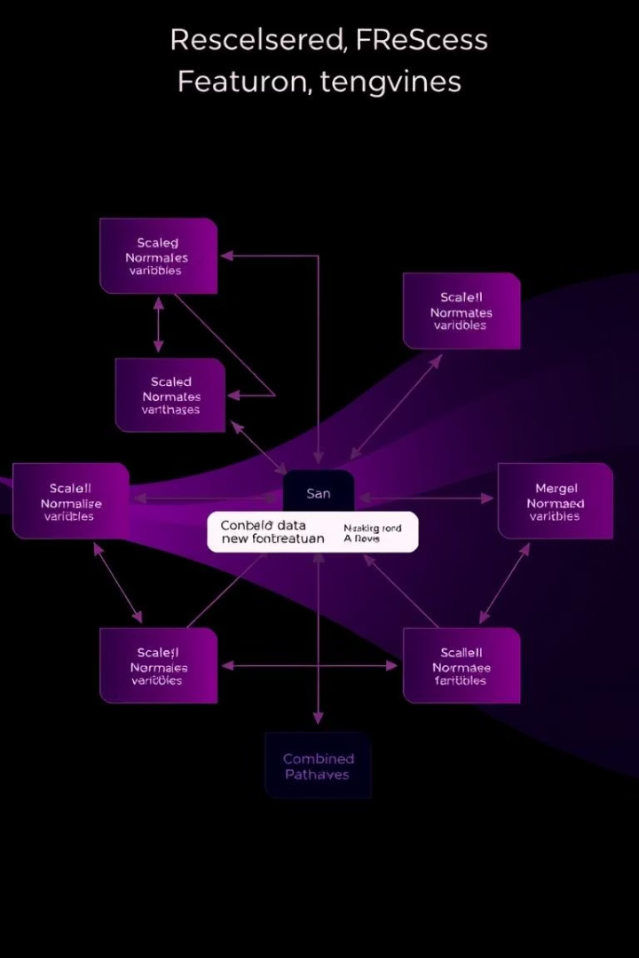
Feature Engineering
Create New Features
Example
Combine acidity metrics to capture total acidity effect
Combine related features to add predictive power
Purpose
Improve model accuracy and interpretability

Slide 9
Machine Learning Models
Linear Regression
Random Forest
Support Vector Machine
Data Split
Predicts quality as a continuous variable
Ensemble method capturing non-linear patterns
80% training, 20% testing for robust evaluation
Powerful for classification tasks

Slide 10
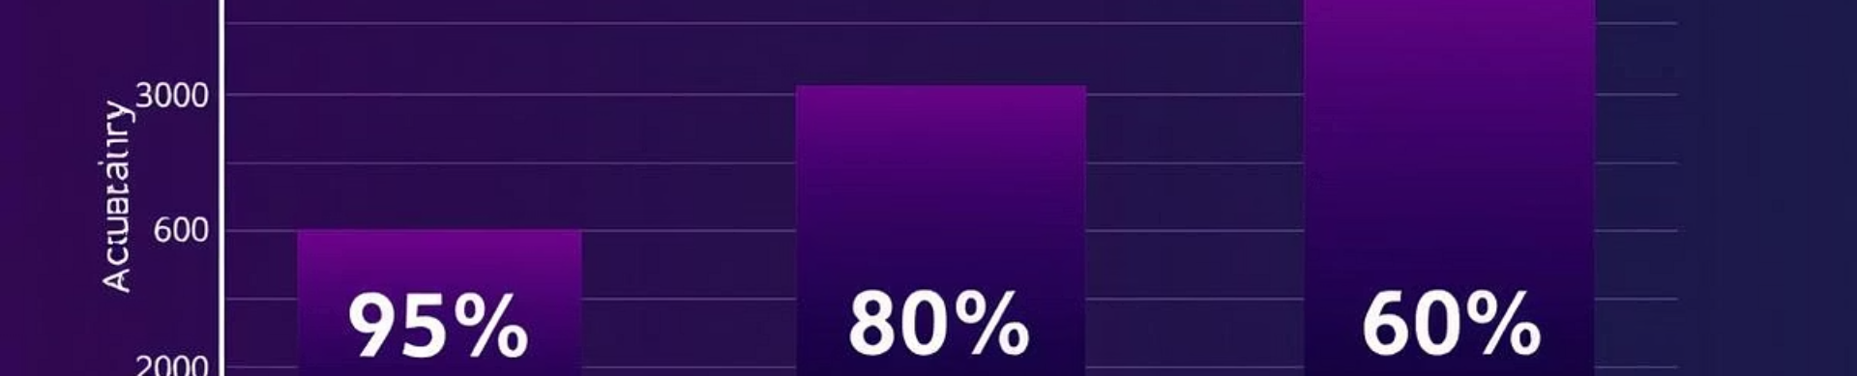
Model Evaluation and Comparison
Metrics
Accuracy
Mean Squared Error and R-squared for regression
Assessed for classification approach
Performance Comparison
Model Selection
Identify best model using test data results
Choose model optimizing accuracy and generalization

Slide 11
Conclusion and Future Work
Key Findings
Future Work
Quality prediction driven mainly by acidity and alcohol levels
Hyperparameter tuning to improve accuracy
Deploy model for real-time assessments
Explore white wine quality prediction

Slide 12

Thank You !

